Slide 1
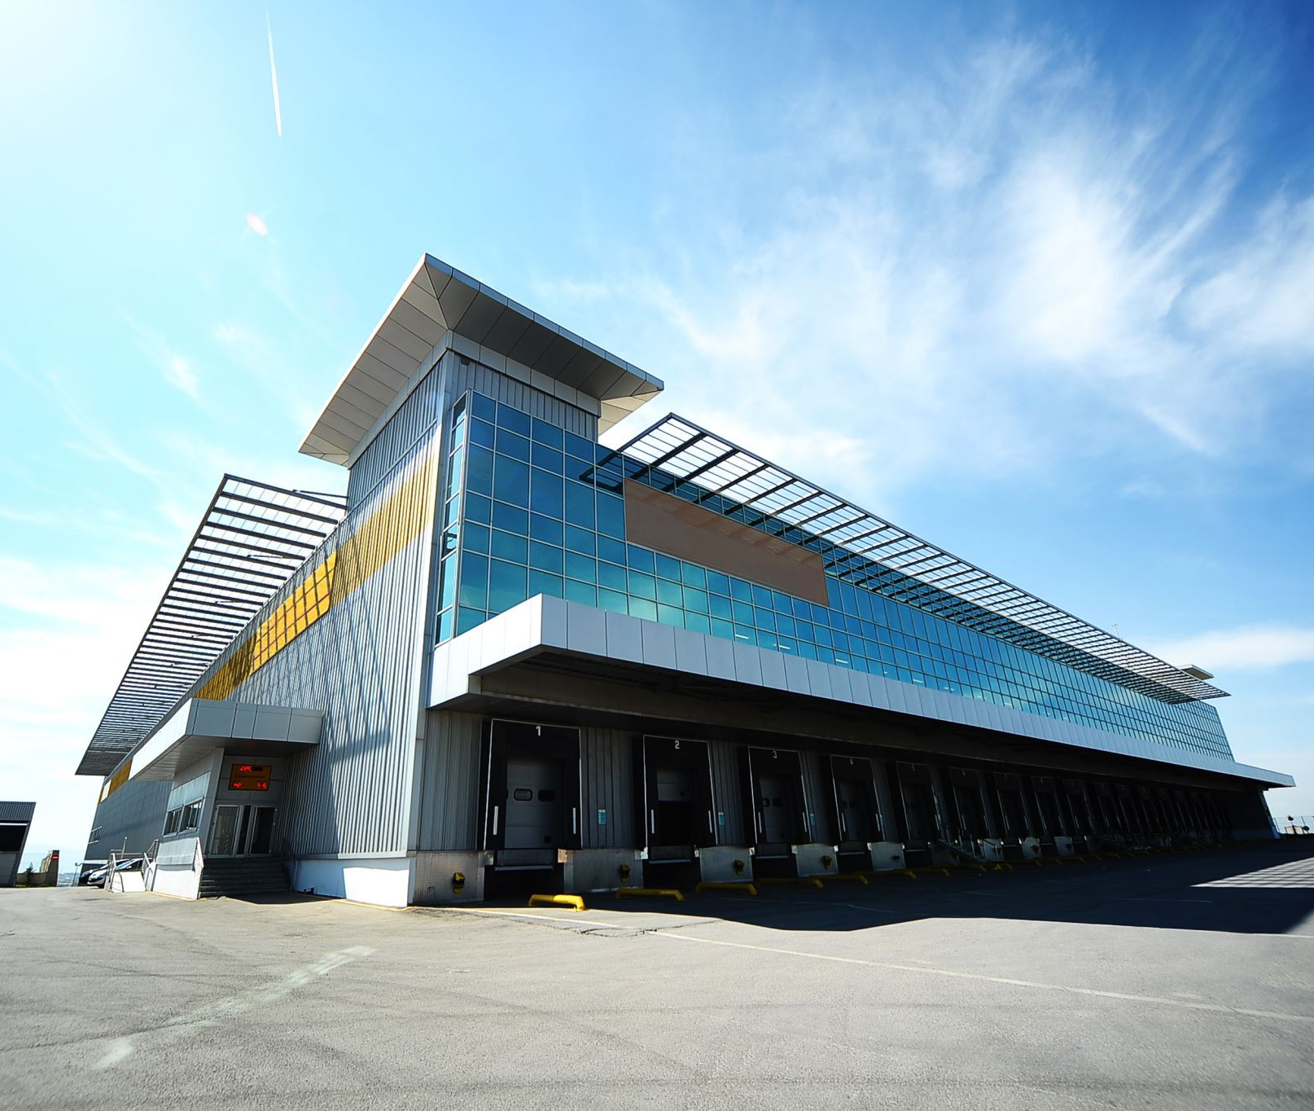
Project Title: Comprehensive Development and Financial Viability of a Multi-Functional Shopping Centre
Presented by
Md Mizanur Rahman
ID: 01-026-08

Slide 2




Project Background
Strategic Location
Located near city center and residential areas, capitalizing on high consumer traffic and accessibility
Multifunctional Design
Includes retail, dining, and entertainment spaces, designed for diverse customer needs.
Sustainability Integration
Design emphasizes eco-friendly building practices for long-term environmental impact reduction

Slide 3




Aims and Objectives
Aim
To establish a state-of-the-art, sustainable shopping center that serves the local community and drives economic growth.
Objectives
Design a multifunctional space that enhances consumer experience, ensures financial sustainability, and integrates sustainable practices.
Financial Focus
Achieve a positive cost-benefit ratio through strategic financial planning and cash flow management.​

Slide 4


Literature Review
Multifunctional Space Design
Design strategies focus on creating cohesive spaces that enhance consumer experience and increase foot traffic.
Theoretical Framework Consumer behavior, architectural design impact, and sustainable development principles applied to the project.
Sustainability
Principles of economic, environmental, and social sustainability guide the project's design and operation.​

Slide 5




Methodology
Data Collection Techniques Market research, stakeholder interviews, and surveys provide qualitative and quantitative data.
Analysis Methods Statistical analysis, cash flow projections, and sensitivity analysis assess project feasibility.
Design and Construction Incorporates modular designs and sustainable building practices, including LEED certification

Slide 6




Financial Analysis
Cash Flow Projection
5-year projection showing 10% annual revenue growth and declining operating costs over time
Cost-Benefit Ratio
CBR of 1 to 1.28, demonstrating the project's profitability potential over time
Revenue Streams
Income from room rentals, restaurants, and business facilities expected to drive profitability

Slide 7




Conclusion and Recommendations
Key Findings
The project is financially viable with a favorable cost-benefit ratio and 10% revenue growth expected annually
Recommendations
Diversify services, implement sustainable practices, and maintain financial controls for long-term success
Long-Term
Viability Sustainability and adaptability ensure the project remains competitive and profitable

Slide 8


Thank You

